Slide 1
Summary of Cloud Computing (CC)
from the paper
Abovce the Clouds: A Berkeley View of Cloud Computing (Feb. 2009)

Slide 2
Definitions (I)
Cloud Computing refers to both the applications delivered as services over the Internet and the scalable hardware and systems software that provide those services. The services themselves have long been referred to as Software as a Service (SaaS).

Slide 3
Definitions (II)
The scalable hardware and software is what we will call a Cloud.
When a Cloud is made available to the general public, we call it a Public Cloud. This often means that one can access a cloud for free or in a pay-as-you-go manner.
The service being sold is Utility Computing.

Slide 4
Definitions (III)
We use the term Private Cloud to refer to scalable hardware and software of a business or other organization, not made available to the general public.

Slide 5
Characteristics of clouds
illusion of infinite computing resources (because of scalability)
elimination of an up-front commitment by Cloud users, thereby allowing companies to start small and increase hardware resources only when there is an increase in their needs
The ability to pay for use of computing resources on a short-term basis as needed (e.g., processors by the hour and storage by the day)

Slide 6
Why CC now? (I)
economies of scale (prices of 2006):
infrastructure costs (eg, electricity)

Slide 7
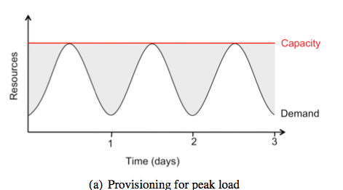
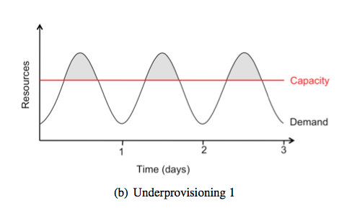
Why CC now? (II)
load balancing difficult in private data centers:

Slide 8
Why CC now?
large Internet companies (amazon, Google, etc.) had to run huge data centers anyway as their core business with excess capacities => additional revenue stream that also reduces excess capacities
by having to run huge data centers they significantly improved the technology to manage them
improved internet infrastructure

Slide 9
Spectrum of CC
computational model (VM):

Slide 10
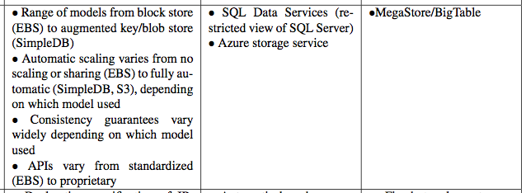
Spectrum of CC
storage model:
Amazon Web Services
Microsoft Azure
Google AppEngine

Slide 11
Spectrum of CC
networking model:
Amazon Web Services
Microsoft Azure
Google AppEngine

Slide 12
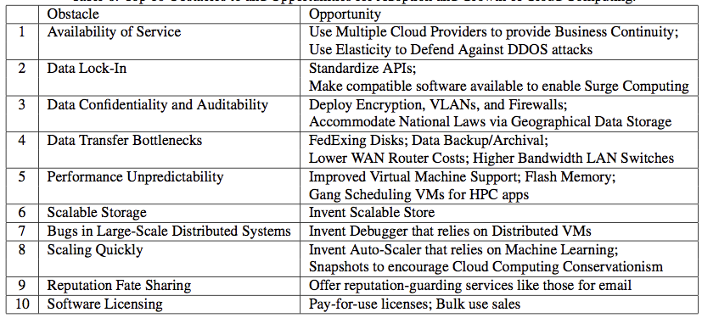
Top 10 Obstacles and Opportunities for CC

Slide 13
1) availability
down-time of dominant cloud providers is extremely low
but: cloud is a single point of failure; using multiple clouds (redundancy) is not an option today (incompatibility)
Distributed Denial of Service attacks: target shifted to cloud provider

Slide 14
2) data lock-in
clouds are currently proprietary
problem if more specific clouds are used
speculation: standard APIs not to be expected in the near future (5 years)

Slide 15
3) data confidentiality and auditability
technology perspective: encrypting data before placing it in a cloud may be even more secure than unencrypted data in a local data center
political perspective: laws that require customer/citizen data to be kept within national/EU boundaries

Slide 16
4) data transfer bottlenecks
10 TB: 10 ∗ 10¹² Bytes / (20 × 10⁶ bits/second) = (8 × 10¹³)/(2 × 10⁷) seconds = 4,000,000 seconds, which is more than 45 days
remedy: express mailing of disks

Slide 17
5) performance unpredictibility
main memory: no problem
I/O: 16% variability remedy: flash memory
high performance computing: requires synchronized scheduling of tasks, which today's VMs and operating systems do not provide
remedy: "gang scheduling" for CC

Slide 18
6) scalable storage
problem: varying richness of query and storage API, of performance guarantees and the complexity of data structures
research opportunity: create CC storage system that overcomes these limitations

Slide 19
7) debugging in massively distributed systems
problem: bugs often cannot be reproduced in smaller configurations
research opportunity: create appropriate VMs/debugging concepts and tools

Slide 20
9) reputation fate sharing
one cloud user's bad behavior can affect the reputation of the cloud as a whole
remedies: reputation-guarding services !?
question of transfer of legal liability: for example, is the conpany that sends spam or the cloud provider liable

Slide 21
10) software licensing
CC incompatible with one-time purchases
remedy: pay-as-you-go licensing models

