Slide 1

Department of Social and Economic Science November 5th, 2013
Islamic Finance
Is It an Economic OR Religious System? By
Dr. Aly Khorshid
University of Reading, ICMA Centre, Henley Business School

Slide 2
Economic System
Is a system of the production trade and consumption of goods & services.
The economic agent can be individual, businesses, or Government
Transaction occur when two or more parties agree to the value or price of the transacted goods or service in an agreed currency
The currency or money is a medium of exchange (Money was created by the ancient Egyptian approximately 2000 years BC )
Market base economy where goods and services are exchanged freely without interference according to the demand and supply by barter or exchange of money
“Adam Smith defined economy as the products offered at a national price generated by the use of competition , while Governments should only regulate for abuse and control monopoly , Transparency and information is essential element for free market economy”
Economics activities are measured by GDP, consumers spending, Exchange rate, stock market, national debit, inflation rate, balance of trade, unemployment and interest rate

Slide 3
Different Economics system
Capitalism
Competition is on free market the price, production and consumption of goods based on demand and supply, the trade privately owned and managed for profit.
No regards to unemployment, social growth
Communism
All property and capitals are owned and managed by the state including economic activities, enterprise, labour, production and consumption.
Employment is the state to provide, wages are set by the state according to the national output
Islamic System
Market base economy, where goods and services are exchanged freely according to the demand and supply by barter or money with debit or credit value
Entrepreneurs are encouraged to create wealth throw employment and social activities
It is a balance between the two systems, it is emphasis both individual economic freedom and the need to serve the common good

Slide 4
Religion
Religion is an organized collection of beliefs, faith, cultural system, ethics, morality and way of life
Almost all religion believe in God
The global sensor 2012 reports that the world population has reached 6.9 Billion of which 2.0 Billion 31% Christians, 1.7 Billion 23% Muslims, 13.8 Million 0.2% Jews and 59% are religious and 41 % non-religious.
Religion and business have been throughout the history interacted and affected one anther as well as influencing social-culture and politics, for example labour laws in the UK labour law as well as USA prohibited to discriminate against religion
To me Religion is a close relationship between me and God, I can ask him for guide, forgiveness

Slide 5
Can Economy and Religion mix
The practice of religion is between the person and his God in forms of pray or meditations, and in daily life such as marriage, funerary service, public service and charities
Economic systems are manmade system to regulate and reform trade:
Throw history economic systems have taken a form of trying and testing of what to produce? How to produce? Who gets what is produced?
Efficacy, growth, liberty and equality are objectives to achieve in good economic systems
In capitalist economic system production carried out to maximize profit, while in socialist systems labour and jobs is the goal

Slide 6
Islam
• The word Islam means
“submission” or “total surrender” to God,
• Islam is a Holy religion that came to the world some 1443 years ago in the year 578.
• There are 1.7 billion Muslims in the world (23% of total world population) with annual growth of 15% (in 2020 Muslim population expected 25% of the world population) ,
making it 2nd largest religion after Christianity. Only 20% of those live in Arab Countries.
God Revealed the Qur'an to people through his last messenger, Prophet Mohammed ”BPUH”.
The Qur'an is the holly book.
Mohammed's words and deeds are called Sunnah; both are the fundamental sources of Islamic law, known as Shariah.

Slide 7
Islam
The five pillars of Islam:
1. Shahabad (profession of faith)‏
2. Salat (prayer)‏
3. Zakat (giving of alms)‏
4. Sawm Ramadan (fasting during the month of Ramadan)‏
5. Hajj (pilgrimage to Mecca for those who are able physically and financially)‏

Slide 8
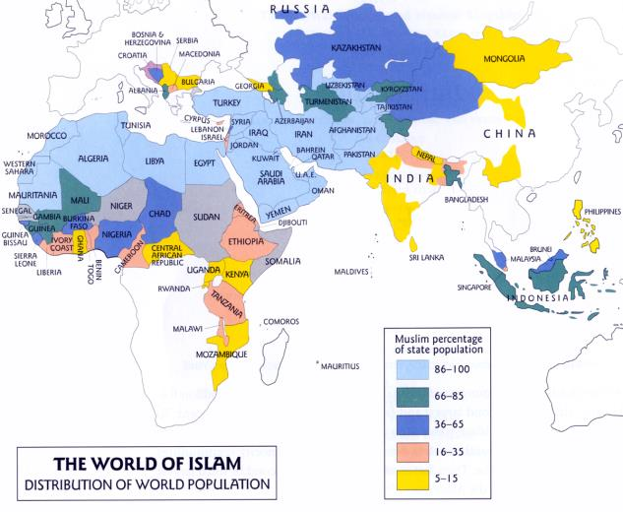
There are 1.7 billion Muslims in the world (23% of total world population) with annual growth of 15%
in 2020 Muslim population expected 25% of the world population
Only 20% of those live in Arab Countries.

Slide 9
Shari'ah law
Justice, fairness and morality
Are values which underpin both the entire Islamic way of life.
Shariah gives guidance as to what is, and what is not, acceptable behaviour in all areas of a Muslim’s life
Shari'ah is developed by Shari'ah scholars (Known as Schools of thoughts, Safaai, Hanafi, Hanbali, Malki, Sheaat ,etc. ) over 1000 years ago (over 400 years after Islam)
The recent Scholars known as Shari'ah advisors or Shari’ah board has studied Fiqh Al-Muaamlat able to explain Shari'ah law for recent business dealings.
The principal base of the Shari’ah Law is:
the permissibility, the prohibition is exceptional

Slide 10
What is Islamic Finance?
Islamic Banks Started in 1974 in Egypt with the first Islamic Bank “Nasser social bank” followed by Islamic development bank in 1975, now there are over 600 Islamic Banks globally
Islamic Banks started as interest free bank to help the small entrepreneurs to start business, the costs of managing the bank charged the stack holder as expanses
The framework of an Islamic financial system is based on elements of Shari'ah(Islamic Law) which prohibit Riba (Usury) and Gharar (Deception) and permit Risk sharing
The fundamental concept is that the money has no inherent value and should be used as a measure of worth
Shari’ah compliant investment are structured on the exchange of ownership in tangible assets or services with money acting as the payment mechanism to effect the transfer of ownership

Slide 11
Shari’ah Law
Recent Islamic scholars who from time to time re-examine the Shari'ah principals have structured new financial instruments
Those instruments must comply with principals of The of Shari'ah law
Ethics of the Shari’ah Law originate from:
The Qur'an
The Sunnah,
Ijmaa - consensus among the jurists,
Qiyyas – analogy
Ijtihad - reasoning

Slide 12
Prohibition In Islamic financial system
Riba (Usury)
Short Sale (Future or goods you do not own)
Gambling
Gharar (Deception, Speculation)
Monopoly
Money Trading (money is payment mechanism)
Unfair & Unjust Contracts
Unlawful & unethical trade

Slide 13
Prohibitions In Islamic financial system
Prohibition of Unfairness & Unjust
Prohibition of Riba (usury)
Prohibition of Gharar (Deception & Speculation)
Prohibition of Gambling
Prohibition of Monopolies
Prohibition of Short Sales
Prohibition in money trading (Money is a medium not a commodity)
Prohibition of Dealing in Unlawful or Unethical Goods or Services

Slide 14
Shari'ah Compliant Products
Products that exchangeable for money)
Products are not prohibited in Islam
Products that are not monopolized by one party
Products are not traded under duress
Products are traded in the open market
Products that are free from Riba

Slide 15
Shari'ah Compliant Products
Products that exchangeable for money
Products are not prohibited in Islam
Products are not traded under duress
Products that are free from Riba
Products are traded in the open market
Products that are not monopolized by one party

Slide 16
Islamic Finance Contracts
Because of the importance of money to all human being, regardless of his or her beliefs
Islam has addressed this issue in general terms, and gave societies the choice to develop their own financial systems, as long as the system is
Fair & Just
To everyone

Slide 17
Global development of Islamic Finance
Islamic Finance is fastest growing segments of the Global Financial services Industry
Global Islamic banking assets with commercial banks reached $1.6 trillion in 2013 (2011: $1.3 trillion), representing average annual growth of 17%
Islamic banking growth by 50% faster than overall banking sector in several core markets
Shari’ah compliant financial assets have been growing at rate 20-25% over the last 10 Years estimated at US$ 1.8 Trillion in 2012, That represent only 1.2 % of the global financial system
Still to small sum considering China Construction Bank hold US$ 2.6 Trillion in assets

Slide 18
Islamic finance contracts (Tools)
Musharakh
Mudarabah
Murabaha
Ijara Contracts, etc.
Salam
Istisna'a
Bai be Thaman Ajil
Sukuk
Arbun
Qard Hassan
Tawarruq
Home Financing
Musaqaa
Muzara
Ijara Wa Iqtina

Slide 19
Islamic finance contracts (Tools or Instruments)
Musharakh( Equity financing)
Mudarabah(participation or Trust finance)
Murabah(Cost-plus financing)
bay’ bithaman ajil (BBA)
Ijara (Operating lease)
Ijara wa Iqtina(Finance lease)
Istisna’a(Construction financing)
Bai Salaam(Payment for future delivery)
Arbun(Pre-purchase of right to acquire)
Sukuk( Islamic Bonds issue)
Tawarruq (opposite Murabaha)
Home Financing (Islamic Mortgage)
Qard Hassan (Interest free loan)
Musaqaa (Aggregation)
Muzara (Cultivation)

Slide 20
RISK’s FOR conventional BANKS
CREDIT
OPERATIONAL
MARKET
FOREIGN EXCHANGE
Interest Rate Risk
RISK
REPUTATION RISK
SOLVENCY
&
LIQUIDITY
RATE OF RETURN
EQUITY INVESTMENT RISK

Slide 21
Risk’s For Islamic Banks
CREDIT risk shared
OPERATIONAL
MARKET
FOREIGN EXCHANGE
SHARIAH COMPLIANCE
RISK
REPUTATION RISK
SOLVENCY
&
LIQUIDITY
RATE OF RETURN
EQUITY INVESTMENT RISK

Slide 22
What make Islamic Finance a Global system ?
Islamic Finance is an economical system based on
Risk sharing (sharing profit & loss)
The Shari’ah explains the ethical concept of the money and capital use ( Money is a medium of transaction not a commodity)
The system prohibit RIBA, but also offers an alternative tools of avoiding Riba
The prohibition of GHARAR (Uncertainty) allowing all transaction to be transparent and free from deception
The system sets the social responsibility for the financial institution to take active part in the economic development to create jobs and generate wealth (such as Sukuk issuance to raise capital from small investors for new project development) not just profitmaking
The system sets the relationship between RISK and Profit

Slide 23
What make Islamic Finance a Global system
Prohibiting trade in Unethical products(such as Pork, pornography and alcohol) help the economy to grow ethically
There are numerous experienced Shari’ah Scholars who are to advise on the Shari’ah compliant activities
Over 60% of investors in Sukuk are non-Islamic corporate investors because its safer investment than Bonds
Although their their are different Schools of thoughts applied in different parts of the Glob, but all Schools agree on the same principals “different opinions benefit the people”
“ for Example Shari’ah interpolation in Malaysia based on Shafie School and other parts of the world prefer anther School , but overall all Schools follow the same path”

Slide 24
Growth During the Crisis
One impact of the Global Financial Crises has been the rise of Islamic Finance because its resilience to such crises
Not one single Islamic Bank anywhere in world has needed to be bailed out by taxpayers or Government (Despite some difficulties in Dubai real estate)
Islamic Banks were not caught up with exposure to the “Toxic Assets” (Assets has no value) which hit the conventional banks
Products offerings and investment of Islamic Banks are relatively secure
The question heir to ask is:
Would the Global crises have occurred if Islamic finance principals had been followed?

Slide 25
Conclusions
Economy and Religion do not mix
Islamic Finance is a global financial system
Islamic Finance is an economic system based on Risk sharing
Islamic Finance is not a religious system, its open for all people Muslim and non-Muslim to take part
Islamic finance is a system of making Money ethically
Islamic finance tools may have different terminology, the global economy apply similar tools, but the risk have not been shared fairly between the parties

Slide 26

THE END
THANK YOU
26

Slide 27

What cause the credit crises
Video: What is the Credit crisis?
source: http://www.youtube.com/watch?v=l4KY9kQhdjU

Slide 28
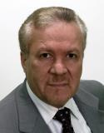
Dr. Aly Khorshid Islamic Finance Scholar & Shariah Consultant Visiting Fellow of Islamic Studies ICMA Censer, Reading University, UK Dr. Khorshid has been involved with financial institutions for over 2 decades with comprehensive skills and knowledge in Islamic finance, Visiting Fellow ICMA centre Henley business school University of Reading, CEO of Islamic finance with Elite Horizon economic consultancy, his role includes Structuring, Endorsing and advising on Shariah complaint products with particular experience in Capital and stock market products, He is experienced in conduct comprehensive Due-diligences on financial institutions to identify potential investment opportunities. Dr. Khorshid has PhD on Islamic studies and economics from the University of Leeds (UK), studied Fiqh and Shariah at Al-Azhar University (Egypt), Master degree in managements (UK). His Publications includes, Islamic Insurance “A modern Approach to Islamic Banking”, and the Encyclopaedia of Islamic finance, Dictionary of Islamic Finance, Corporate Governance in Islamic Finance, “ A TENDER POWER” Novel instigates Islamic Finance for layman within fiction action love story, He also has many articles published on Islamic finance. Dr Khorshid is a trustee member of Academy UK International, member of the institute of management consultancy (UK), and former visiting lecturer in El-Azhar University “Egypt” and ‘SOAS’ University of London on Islamic finance. He is a regular speaker on Islamic finance issues at conferences and TV. Contacts: Email: a.khorshid@icmacentre.ac.uk alykhorshid@mac.com Mobil: +447944411777

Slide 29

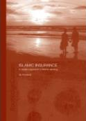
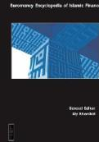
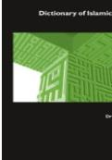

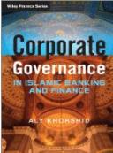
Leading Consultants Development
Advisory Services on Academic and Institutional
Specialised on Islamic Banking and Finance
Experienced in Management and leadership in commercial and academic environment
Authors of more than 5 books and over 70 journal and conference papers
Shari’ah Scholar, board member in several financial and academic institutions
Aly Khurshid, PhD
29

