Slide 1
Safety and
safe working in labs
Safety instructions
by Christian Huber
adapted by I. Gratz
2016
Notes:
1

Slide 2
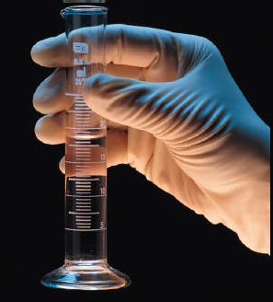
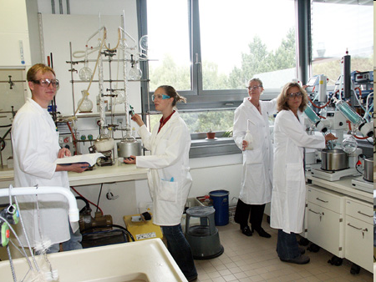
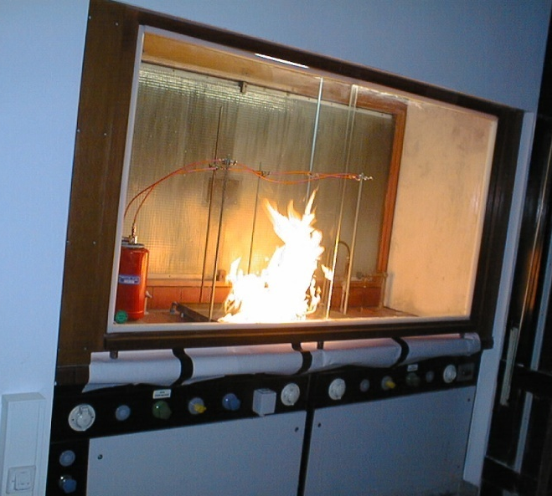
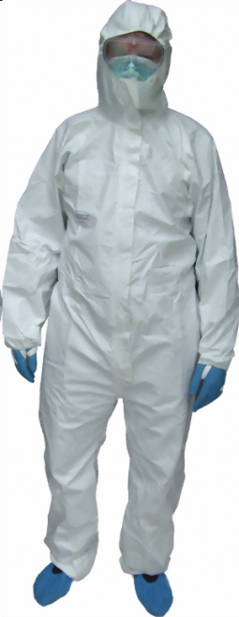


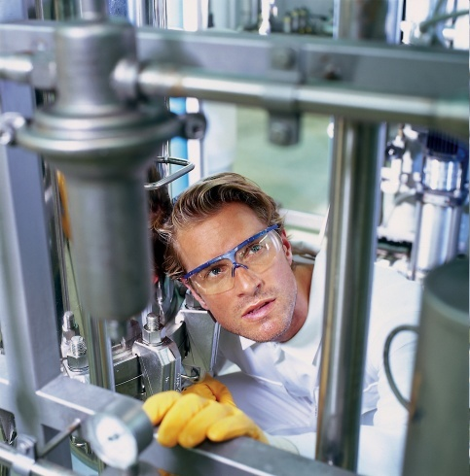

Lab safety matters!!
Notes:
2

Slide 3
Dangers for people
Substances can pose danger for people based on their properties:
  Danger of fire and explosion
Burns of the skin
Poisoning by smoke gas
Mechanical injuries by a blast wave
  Poisonous and corrosive (ätzend)
Severe damage to the health (potentially lethal) by
swallowing, inhalation or resorption via the skin
Damage of (skin) tissue by corrosive substances
Irritation of the respiratory system by corrosive gases
  Chemicals harmful to health and irritating
Irritation of skin, eyes or respiratory system
Risk of cancer caused by swallowing, inhaling or resorption
via the skin
Mutations
Impairment of fertility
Acute poisoning by toxic substances

Slide 4
Safety signs
Safety signs serve to prevent accidents and provide safety in the work space. There are the following safety signs that are color coded:
Fire safety: indicate appliances to fight or signal fire
Rescue and first aid: indicate escape routes or first aid appliances
Instructions: indicate the necessity to behave a certain way to prevent accidents
Prohibition: indicate the necessity to avoid certain behavior to prevent accidents
Warnings: indicate dangers in specific situations

Slide 5





Rescue and first aid
Signs in a room or building that designate the escape route or first aid appliances
Each individual that is new in a room or building has to inform themselves about escape routes and first aid appliances
In case of emergency individuals that are safe have to report to the responsible person of the lab (PI) or the rescue team to identify missing persons for rescue
E01
Guidepost for escape routes, emergency exits, or first aid appliances
E03
First aid
E05
Emergency shower
E06
Eye rinse
E13
Emergency route

Slide 6




Instructions
Signs that give instructions about a work space or whole room/lab (when posted on the door) to put certain safety precautions in place.
The safety precautions are determined by the potential hazard of an action (i.e. lab coats are appropriate for normal chemical work; full personal protective equipment (PPE) is required for working with highly infectious material).
The obligation to wear PPE is not limited by time or the actual work you are doing.
M07 wear PPE
M01 wear eye protection
M06 wear gloves
M13 pull plug before opening

Slide 7






Warning signs
Signs that inform you about hazardous substances or other risks in a room or work space.
When working in a room with safety signs you have to:
Avoid open fire, sources of ignition, flammable substances.
Wear adequate PPE (gloves, eye protection, lab coat, full PPE, gas mask, insulating shoes,...) or work in a fume hood – depending on the specific hazard potential of the used substances.
Secure gas containers; store substances in safety cabinet
W01 warning
flammable substances
W04 warning
Corrosive/etching substances
W03 warning
poisonous substances
W19 warning
gas containers
W08 warning
hazardous electrical voltage
W05 warning
radioactive or ionizing radiation

Slide 8





Prohibition signs
These signs are placed at a work station or at the door and inform about prohibitions in the respective area (i.e. the work station or the whole laboratory)
Prohibitions are always in place irrespective of the work currently performed in the work area.
Smoking, eating or drinking as well as the storage of food are always prohibited in laboratory areas. Even if no specific prohibition signs are in place.
P01 No smoking
P02 Fire, open flame
and smoking prohibited
P06 No access for
unauthorized persons
P19 No food and
drinks
Do not use elevator in case of fire

Slide 9







Labelling of harmful substances
GHS. Globally Harmonized System of Classification and Labelling
GHS, as of 20. 1. 2009 |  |  | Substance - and preparation guidelines
Picto- gram | Danger rating | code | Symbol | Harzard information | Code letter
 | Unstable explosive substances, compound and products with explosives, auto-reactive compaunds and mixtures, organic peroxides | GHS01 |  | Explosive | E
 | Highly flammable, self-reactive substances, pyrophoric, organic peroxides | GHS02 |  | Highly/Extremely flammable | F / F+
 | Oxidizing gas, may cause or intensify fire | GHS03 |  | Oxidizing, Contact with combustible material may cause fire | O
 | Compressed gas liquified gas dissolved gas Refridgerated liquified gas | GHS04 | No equivalent

Slide 10









Labelling of harmful substances
GHS, as of 20. 1. 2009 |  |  | Substance - and preparation guidlines
Pictogram | Danger rating | Code | Symbol | Harzard information | Code letter
 | Metal corrosive, Corrosive to skin and eyes | GHS05 |  | Corrosive | C
 | Acute toxicity | GHS06 |  | (Very) toxic by inhalation (Very) toxic in contact with skin (Very) toxic if swallowed | T / T+
 | Warning, acute toxicity | GHS07 | No equivalent
 | Respiratory sensitizer, Germ cell mutagenicity, Carcinogenicity, Reproductive toxicity, Specific target organ toxicity (STOT) | GHS08 | No equivalent
 | Environmentally dangerous, poorly degradable | GHS09 |  | Dangerous for the environment | N
No equivalent |  |  |  | Harmful by inhalation Harmful in contact with skin Harmful if swallowed | Xn / Xi

Slide 11
H(azard) and P(recautions) sentences
H / P 3-number codes
P264 wash hands after use.
P280 wear PPE.
P261 avoid inhalation of vapors/steam/aerosols.
P285 wear breathing protection if ventilation is insufficient.
P273 do not release into environment.
P390 clean up spills to avoid damage to material.
P302+P352 AT SKIN CONTACT: wash with lots of water and soap.
P332+P313 skin irritation: seek medical aid.
P305+P351+P338 AT EYE CONTACT: gently rinse with water for several minutes. Remove contact lenses. Continue rinsing.
P310 immediately call poison hotline or doctor.
P304+P341 after inhalation: find fresh air, find a position that allows easy breathing.
P342+P311 with respiratory symptoms: immediately call poison hotline or doctor.
P406 store In container resistant to corrosion.
P501 dispose content or container as special, hazardous waste.

Slide 12
Health risks and general hygiene
Food and drinks
Eating or drinking is prohibited in labs with poisonous, mutagenig or infectious materials.
Do not use containers usually used for food or drinks for storing chemicals.
No smoking in labs.
Noise protection
Noise protection may be necessary if devices louder than 85dB(A) are used for prolonged time.
Wash hands after work, before breaks and before eating and drinking
Wear gloves: When working with poisonous and/or irritating substances.
Use skin protection whenever necessary.
Work and home clothes should be stored separately.

Slide 13




Fire safety signs
Signs indicate fire safety devices.
Every individual working in the area has to locate devices before working.
In case of fire emergency:
Alert (Who is talking? What happened? Where is help needed? Point out special circumstances)
Safe (yourself, others, alert others)
Extinguish
F03 fire hose
F05 fire extinguisher
F07 Means and devices
to fight fire
F08 fire detector
(manual)

Slide 14
Prohibitions
Substances with concerning properties:
  Carcinogenic, mutagenic substances, or substances toxic for reproduction („CMR-substances“), e.g. dibutyl phthalate, cobalt dichloride, sodium dichromate
  (Highly) persistent or bio-accumulating substances with toxic properties (so called persistent, bioaccumulating, toxic (PBT-) or. Very persistent and very bioaccumulative vPvB- compounds), e.g. anthracene, musk xylene
  In specific cases substances with concerning properties (e.g. hormones)
These substances are under limited approval by the European Chemical Agency
Use replacements if possible.
Permission is issued for specific applications only.
The following law defines special protection of specific groups such as youth, pregnant or breast-feeding women:
  Regulations for restrictions or prohibitions to employ juveniles (KJBG-VO)
  Maternity protection law (MSchG)

Slide 15

Personal protection equipment
The eye is the most vulnerable organ.
Damage possible:
  mechanical insult (dust, splinters,...)
  Insults by liquids (solvents, acids, bases,...)
  Radiation (UV, light, IR-light,...)
EN 166 and ZH1/703 rules for personal eye protection.
Wear eye protection.
Normal shades do no replace safety goggles!
Eye rinse devices have to be tested regularly.
Every (minor) injury has to be reported to an eye doctor. Dangers can result from slowly resorbing substances or infections of the eye.

Slide 16

Personal protection equipment (PPE)
Adjust your PPE to the work you are doing
best protection and at the same time
make sure you are comfortable
and the PPE is easily cleaned.
Wear PPE when you work with substances that can
harm your skin or enter your body.
In a chemical laboratory are always substances present that warrant wearing a lab coat.
Wear closed shoes.
Wear special full PPE when working with especially dangerous substances (single use overall)

Slide 17
Personal protection equipment
PPE is provided by employer.
Wear PPE when your work has the risk to
break your skin and substances can enter your body.
Wear eye protection when your work has the risk to mechanically damage the eye (glass and metal splinters, capillaries) and when you work with corrosive substances, that means in every laboratroy irrespecitve of the work you currently perform.
Always wear a lab coat because corrosive substances are always present in chemical/biologic laboratories.
Your shoes have to be must be solid and tightly closed.
During especially dangerous work wear special PPE (e.g. single-use overall coats)
Not wearing PPE is a refusal of work regulations – your employer is are obligated to protect your safety and needs your cooperation.
Not wearing PPE can be „gross negligence“
PIs are responsible for enforcement of lab rules.

Slide 18

Personal protection equipment
PPE to protect your skin has to be appropriate for the respective dangerous substance (gases, liquids, solids). Several classes of gloves can be used in addition to prophylactic skin protective cream and follow-up treatments.
Unfortunately, there is no universal glove for all hazardous substances. There are special gloves made from particular materials for several substances that will protect against one class of substances very well but poorly or not at all against others.
Reasons against wearing gloves at all times:
You run the risk of inadvertently contaminating places that you do not suspect such as door handles, windows, fridges, the phone, computer keyboards and other technical devices.
Gloves create a damp milieu that can damage the skin.

Slide 19
Tidiness and cleanliness
Tidiness and cleanliness are essential when working with hazardous materials.
Remove obstacles from floors.
Containers for hazardous substances have
to be closed tightly right after use.
Hazardous substances that will not
be needed any more on that day have
to be placed back into storage.
Avoid unnecessary contamination
of devices.
Clean the work space with the appropriate
cleaning aids/detergents.

Slide 20
S1/S2 waste disposal
Particularly TC-waste, viral or bacterial waste
Treat liquid waste from human material with Korsolex (1%) and NaOH
Collect all liquid waste in collection bottle daily
Autoclave all waste from human tissues (blood and skin cells) and from genetically altered mice
  Use autoclavable bins
Use designated hoods for your work – minimize cross contamination
Separate harmless waste from S1/S2 waste to minimize autoclave waste
Implement a log book for all S1 and S2 work

Slide 21








Disposal of lab chemicals

Slide 22

Further resources

Slide 23
Safety features in all lab spaces (e.g. tissue culture, flow room and the animal facility)
Familiarize yourself with the safety features of every work environment
  Where are the next emergency exits? (You always want to know two routes)
  Where are eye flush and first aid kits?
  Where is the next fire extinguisher?

Slide 24
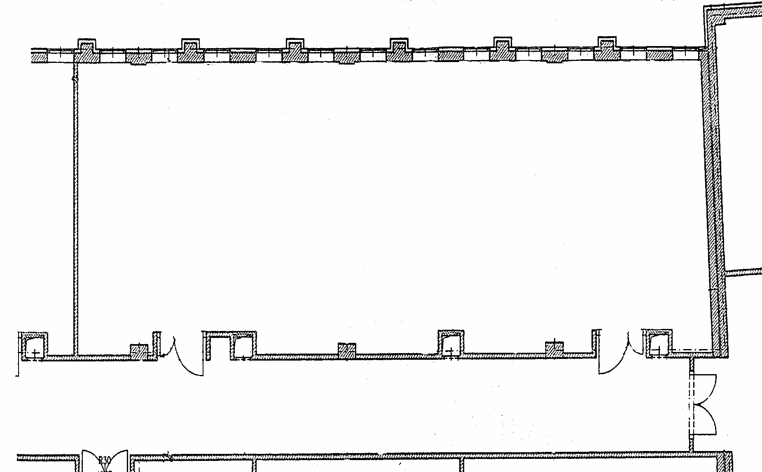

Safety measurements in our lab
!
x
emergency
„power off“
Fire blanket
First aid kit
Eye rinse
hallway

Slide 25
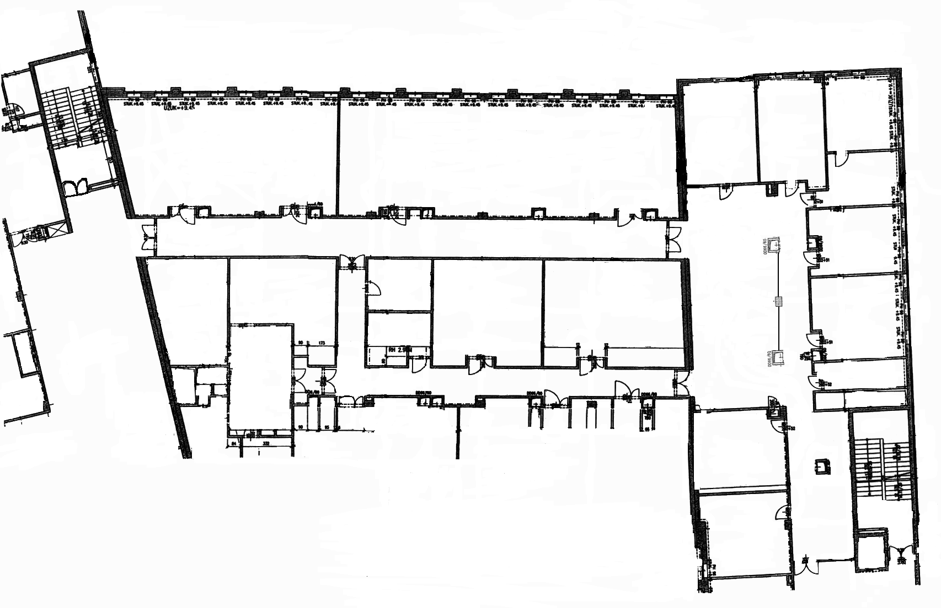
Escape routes and fire extinguishers
Toward pond
Stiege 9
Our lab
Gang
1st floor
N
Stiege 10
S
Toward main entrance

Slide 26
Escape routes and fire extinguishers
Toward pond
Stiege 9
Our lab
Gang
1st floor
N
Stiege 10
S
Toward main entrance

